Slide 1
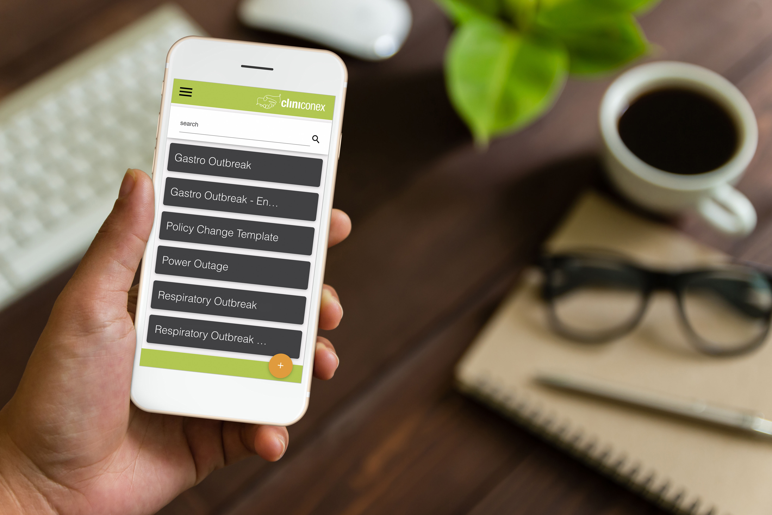


Automated
Care Messaging
Notes:
SCRIPT
Thank you for joining me today to talk about Automated Care Messaging and how it can help you organization. Let’s get started.

Slide 2


Creating a future where healthcare teams can seamlessly communicate, collaborate and connect within their communities.
Notes:
SCIRPT
To start, let me tell you a little bit about Cliniconex, the makers of Automated Care Messaging.
Cliniconex automates patient engagement as the leading communication and collaboration solution for more than 2,600 senior care facilities and 5,000 medical providers, returning 1 million hours to direct care every year.

Slide 3






The challenge for senior care organizations lies in meeting the complex needs of diverse residents while ensuring regulatory compliance, attracting and retaining skilled staff, managing rising costs, and adapting to evolving healthcare regulations and industry standards.
Notes:
SCRIPT
They have been helping care providers for over 10 years and have a deep understanding of the senior care industry and the pain points of everyone in a care team, from nursing staff to residents and their families and beyond.

Slide 4

Automated Care Messaging empowers senior care organizations to establish a family-centred care team before, during, and after care.
Notes:
SCRIPT
This knowledge led to the creation of Automated Care Messaging, which empowers senior care organizations to establish a family-centred care team before, during, and after care

Slide 5






With ACM, senior care organizations can effectively navigate the complexities of the industry and provide high-quality care while remaining compliant and adaptable.
Streamline operations, enhance resident care experiences, and meet regulatory requirements.
Notes:
SCRIPT
With Automated Care Messaging – or ACM for short – senior care organizations can effectively navigate the complexities of the industry and provide high-quality care while remaining compliant and adaptable
Streamline operations, enhance resident care experiences, and meet regulatory requirements.

Slide 6
How Automated Care Messaging Works
Notes:
SCRIPT
Now let’s dive into the technical sections and see how ACM actually works

Slide 7
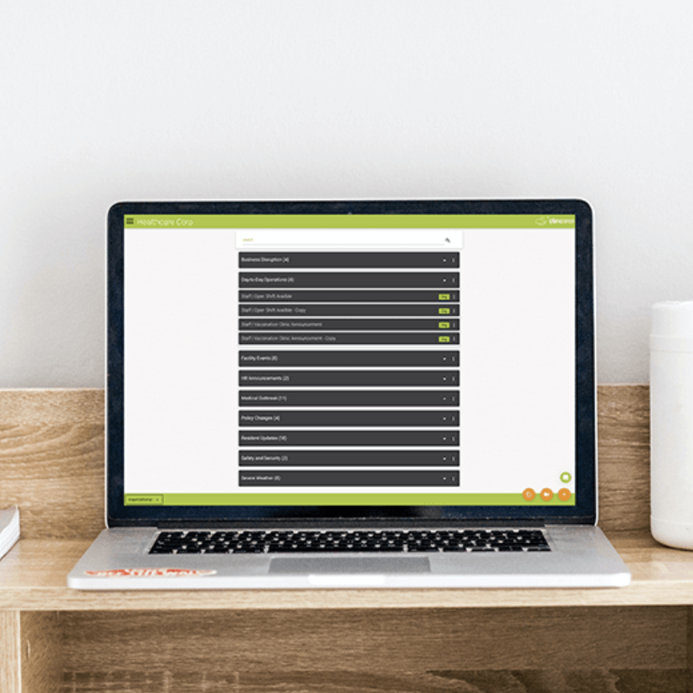
ACM is a product, not a project.
Onboarding takes less than 1 hour, and most users onboard themselves.
Notes:
SCRIPT
First off, ACM is a product, not a project.
What does that mean?
It means that you are up and running with the Messaging section of the app within 24 hours of API activation.
You can then choose to have a one-hour personalized onboarding session, or, you can choose what most users choose and that is to onboard yourself.
It’s really that simple. If you can send an email, you can use ACM – you do not have to be tech-savvy at all.

Slide 8



A 3 in 1 solution.
*add-on
ACM Family
ACM Staff
1
2
3
Urgent
Routine
Staff
Notes:
SCRIPT
Everything about ACM is built on the idea of easy as 1,2,3
This concept applies to the modules of ACM as well.
I’ll dive into the specifics of each module later on but here is a general overview
First we have ACM family which is comprised of two modules.
T he first is the Messenger or urgent app. This is a web-based app – which means you can access ACM from anywhere you have internet access. On your phone or computer, at home or on vacation.
Our Routine module is connected to PCC’s Resident Event Calendar to send automated reminders for events, appointments or anything you put in your calendar. This is truly a set-it-and-forget-it module.
And third, we have our Staff Add-on. This is the same UI as Messenger in ACM Family, and allows you to contact staff, volunteers or other stakeholders. This module work by pulling data from your HR or Payroll system, or, you can manually manage your contacts via a spreadsheet upload allowing you to change and manage your data as often as you need.

Slide 9



1
Use/edit a template
Urgent
Easy as 1,2,3.
2
Filter your audience
3
Send
Notes:
SCRIPT
Now we’ll dig deeper into how each module works, starting with ACM Messenger
As you can see – it really is as easy as 1,2,3
You simply choose a template to edit, or, write your own
Filter your audience
And send
You’ll see in the demo section how easy it really is.

Slide 10
Create event types and templates
1
Routine
Easy as 1,2,3.
2
Set your workflow rules
3
Launch
Notes:
SCRIPT
You can see the same principle applies for Routine
Even better, is you only have to spend an hour on this once. Then it’s the magic that runs in the background
You spend one hour with our onboarding team creating event types and message templates in your calendar. This could be things like offsite appointment reminders, intake meetings or care conferences
Second, you set your workflow rules. For example, For care conferences, you may want a reminder going out 7 days before and then a reminder the day before. While for offsite appointments, you may only want one reminder. We work with you to configure rules to work for your organization
And lastly, we launch your workflows and that’s it.

Slide 11
What you won’t have to do
1
Keep separate contact lists
2
Spend time logging
3
Spending overtime on outreach

Slide 12

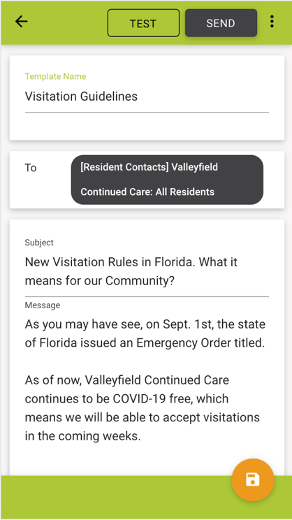
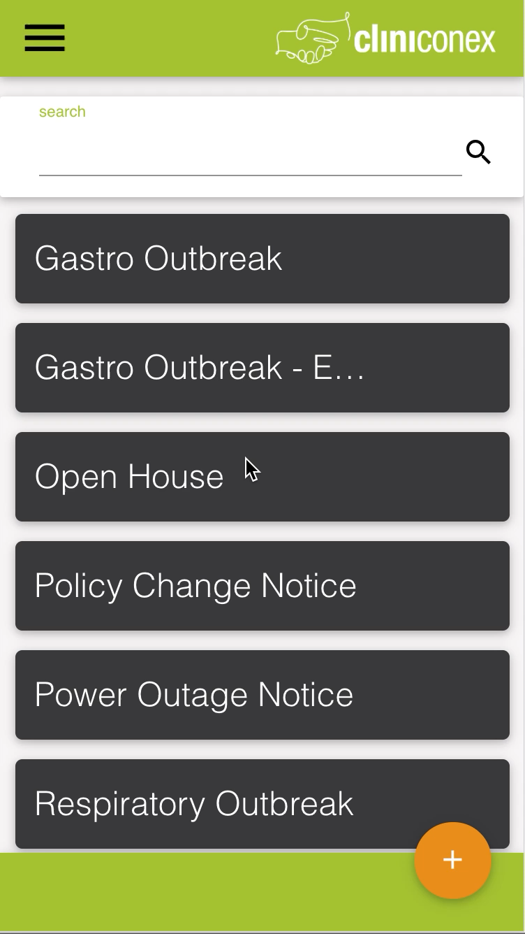
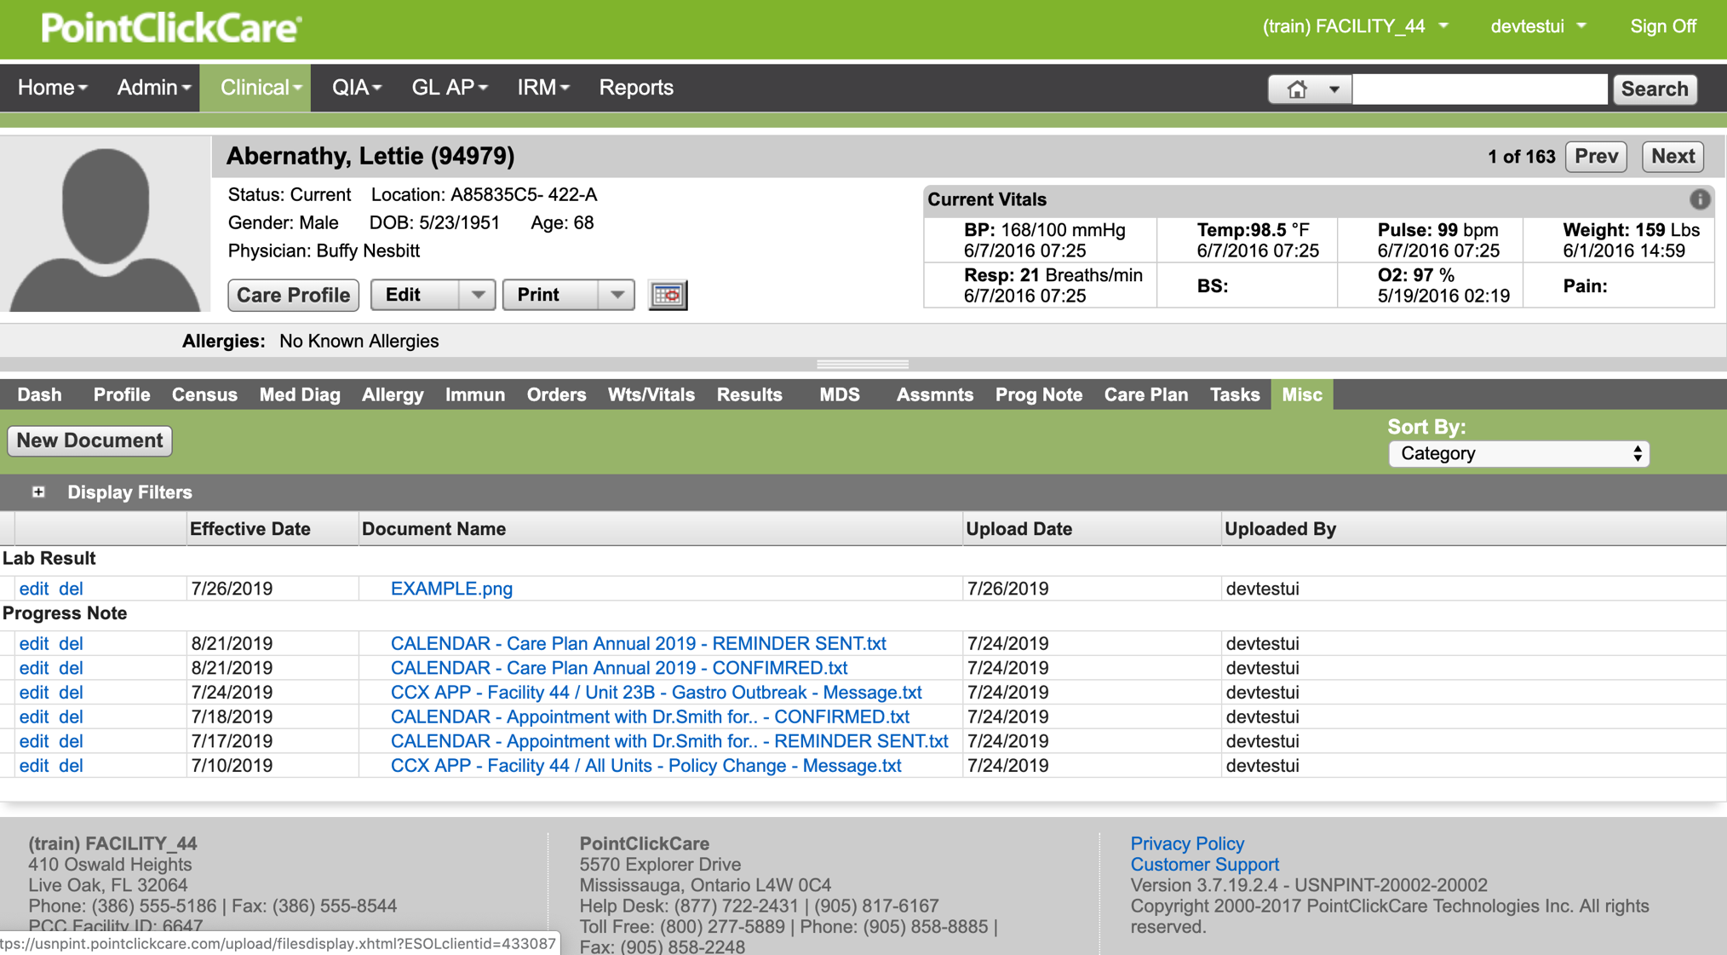
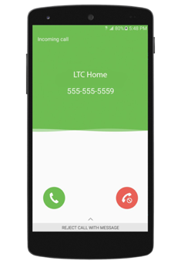
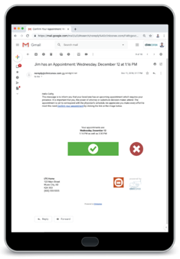

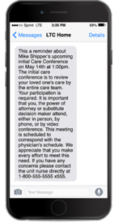
ACM syncs with your PointClickCare EHR to pull existing resident and family contact information.
Send messages via voice, text or email.
1
3
2
Notes:
SCRIPT
So now for the technical part
How does this all work?
ACM is synched to your PCC EHR and pulls and the existing resident and family contact information you have so painstakingly entered
This means you don’t have to pull other lists, or keep emails groups and spreadsheets constantly up to date every time you want to d outreach
This also means you can contact anyone in your EHR, current and discharged residents, and even new residents who may not have moved in yet. If they are in PCC, you can contact them with ACM.
How do you currently send messages? [riff off answer]
ACM allows you and your resident families to choose how outreach is received, either by text, voice or email.
Our hierarchy system let’s your rank text/voice/email according the needs of your organization. You can also do this at a facility level
Furthermore, families can let you know their preferences. So, if your organization has identified that you want your messages to go as calls, an individual can request they get texts. This is done by simply adding a preference code in the comments section of the contact record.
And third logging.
This is automated too.
Because we are synced to PCC, an automatic log is created of each communication and appears in the Misc. tab of the resident’s chart. You can see when a message was sent, who sent it, the contents of the message, etc, aking auditing a breeze.
Reporting is available both in app, and through detailed logs, you can email yourself or colleagues.

Slide 13

Our Impact. Your Outcomes.
Notes:
SCRIPT
I know this has been a lot of theoretical information
So here are some tangible numbers to show you about the impact and outcomes provided by ACM.

Slide 14

Most facilities spend 17 hours in manual outreach per event. ACM turns that into 5 minutes.
5 minutes
1 million hours
ACM returns over 1 million hours to direct resident care every year.
Over 2,600 facilities and 4,500 users use ACM to keep their care communities informed.
15 million messages
Hours are saved, more time is spent on care and the need for overtime and agency staff are reduced or eliminated.
200+% ROI
Notes:
SCRIPT
On average, 100 bed facilites spend 17 hours in outreach per event. As I’m sure you know, it’s never a simple 2-minute phone call to provide the information you need. It’s a 10-15 minute conversation.
With ACM, that 17 hours becomes 5 minutes.
Scale that to all the outreach you do in a month or year and the impact is even larger,
Every year, ACM returns over 1 million hours to direct resident care ever year
Currently, over 2,600 facilities in North America use ACM
Most organizations see a minimum 200% ROI after implementing ACM.

Slide 15
1
Comply with regulations
Why Choose
ACM?
2
Manage your reputation
3
Increase operational efficiencies
We Give You Four Huge Advantages
4
Improve emergency communications
Notes:
SCRIPT
I’m guessing that the majority of your outreach over the last 3 years have been about COVID.
And while communication topics may change, some families are not used to a higher level and frequency of communication
Automating outreach lets you communicate efficiently and effectively and has a wide array of benefits including:
Helping you comply with regulations
Managing your reputation
Increasing operational efficiencies, and
Improving emergency communications
What does this look like in practicality?

Slide 16
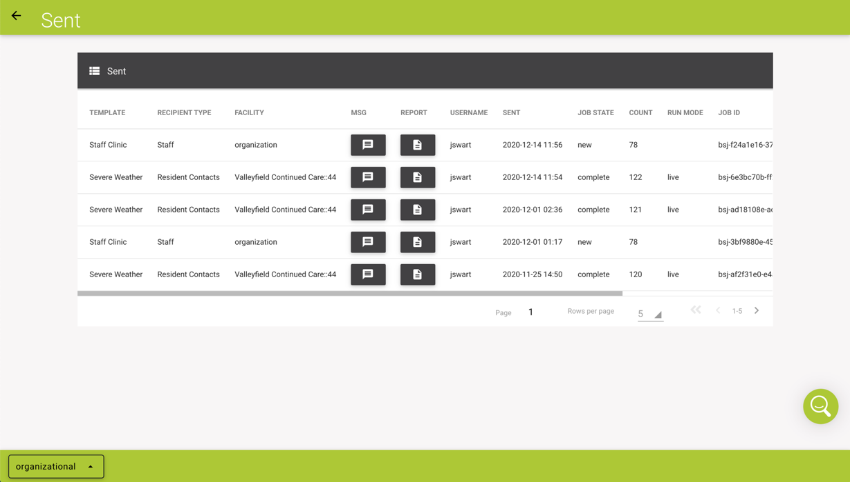
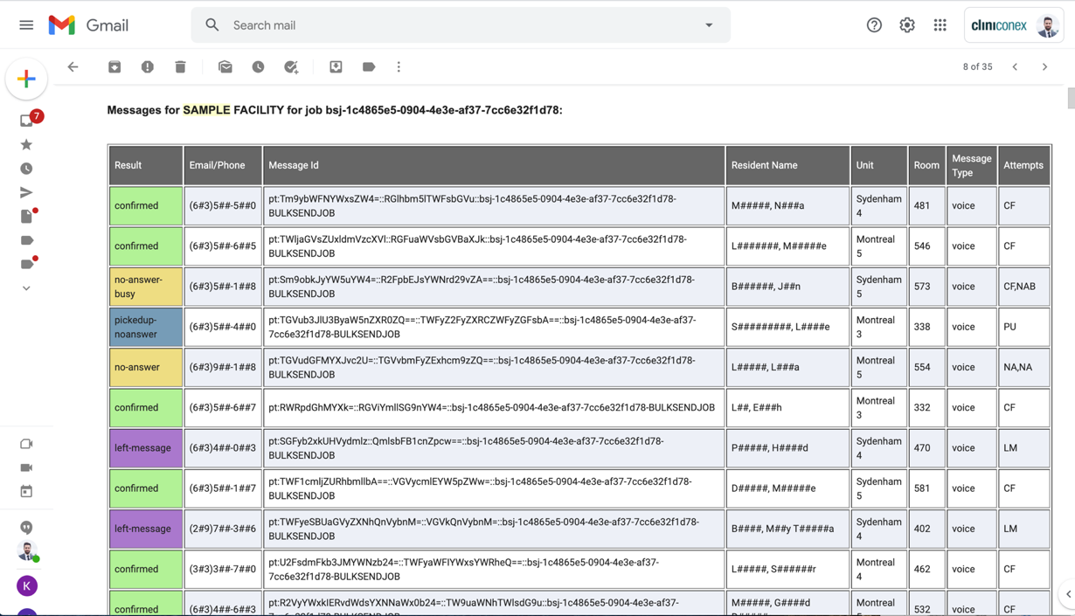
Regulatory Compliance
Use Case | Communication Logs
Before
Send messages to the right contact, at the right time, through the right channel with the right message.
During
A detailed record of each message and its outcomes are automatically logged in the resident chart, creating an auditable trail.
After
Print records for auditors or show records in-app or in the resident chart.
Notes:
SCRIPT
Staying compliant with ever-changing regulations has been very top of mind the last few years, and is still an ever-present concern..
How can ACM help in an audit?
Before an audit or survey even occurs, ACM creates automatic logs in PCC creating an auditable trail you can easily locate
During an audit you can share incredible detail of all your communications including, who the message was sent to, who sent the message and when, the content of the message, the outcome (whether a voicemail was left etc) . Automated logs leave no change that and important information is entered in error, or worse, that critical information is omitted
Not only are communication logs available in-app, they can be printed, sent via email and found in the individual resident’s chart.

Slide 17

Reputation Management
Use Case | Intake
Before
Send a pre-move-in message to welcome your resident and their family and let them know what to expect on move in day.
During
Share a welcome packet and important forms.
After
Let your resident families know how their loved one is settling in. Ask for feedback on the move-in experience with a poll or survey.
Notes:
SCRIPT
Let’s look at reputation management. This is a key element in maintaining occupancy rates and star ratings.
You want to make a strong first impression, and creating a smooth intake and move-in process is a great way to start.
With ACM, since you can communicate with anyone in your EHR, you can start building a trusting relationship with resident before they even move in
Send messages before move-in to welcome the new resident and their families and set expectations or provide guidance for move-in
During the move-in share a welcome package or forms that need signing, ensuring administrative tasks are kept to a minimum on move-in day
After, send a poll or survey asking for feedback on the move-in experience.

Slide 18
Operational Efficiencies
Use Case | Discharge Planning
Before
Invite families to a discharge planning meeting to set the stage for a smooth transition.
Send reminders on the days leading up to discharge with instructions, processes and support.
During
Send forms that need signing or attach information packets.
After
Send wellness check-in messages every few days to see how the resident is doing, remind them of services offered if they need to return, send a survey to rate their discharge experience.
Notes:
We know you have too few staff and too much to do, making both time and resources precious.
I’m also guessing most of your staff got into care to care, not make phone calls and do paperwork.
Here’s how ACM can make your team more effective and efficient. We’ll look at discharge planning as an example.
Before discharge, send an automated message inviting them to a discharge planning meeting to set expectations and create a transition plan that will work for everyone.
Reminders can be sent at intervals of your choosing to ensure the show up informed and on time.
Include forms or information packets to ensure everyone is aware of what is going on can have material to reference if they need
After discharge, send wellness check-ins every few days to see how the resident and their family are doing, and remind them of services offered if they need out-patient appointments, or if they need o return to the facility, greatly minimizing the likelihood of a hospital admission

Slide 19
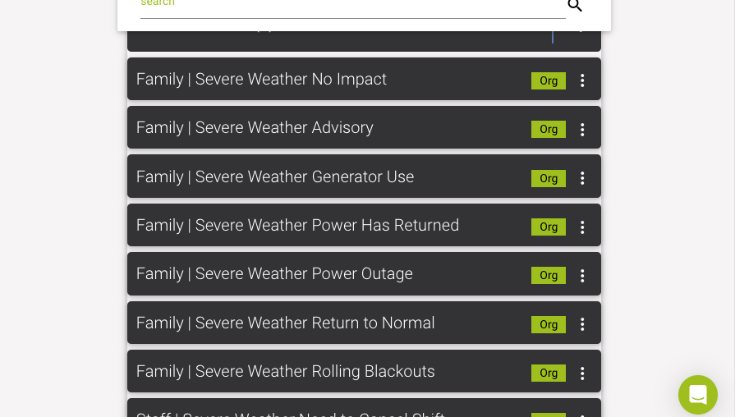
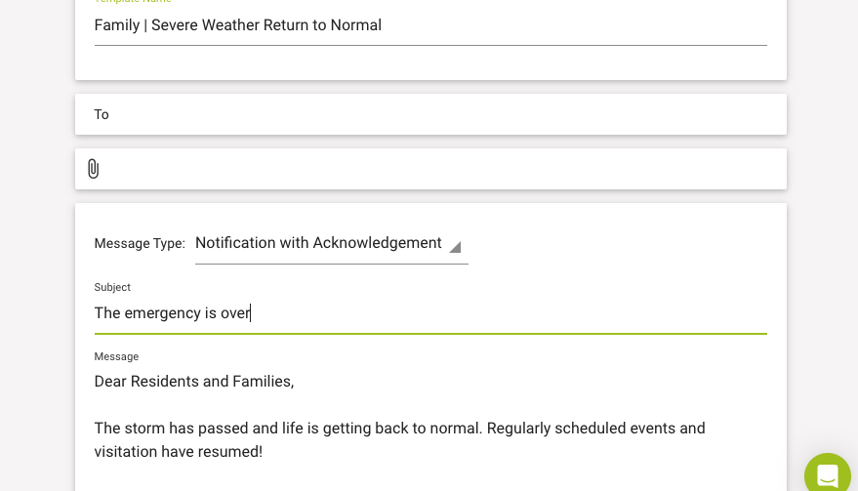
Emergency Communications
Use Case | Templated Messages
Before
Let your care community know you are aware of the emergency situation and what your emergency plan is. Set timelines and expectations.
Share essential care instructions, reminders, and updates on residents minimizing disruptions in healthcare delivery.
During
After
Let your community know the emergency is over, that regular activities are resuming and thank them for their support.
Notes:
Emergencies aren’t something you can predict, but you can plan how you react to them.
And, having an emergency communications plan is mandated section of your overall emergency preparedness plan.
Here’s how ACM help
Use our pre-written templates to let your care community know of an impending emergency situation, how you are preparing for it, and when they will hear from you next
During an emergency, keep your community updated as often as you can. Even it’s to share that nothing serious has happened, This reduces stress, anxiety and incoming calls.
Let you community know when the emergency has passed and of any lingering changes of which they need to be aware.

Slide 20

Surveys and Polls
Use Case | Vaccine Clinic
Before
Send a message in advance of any vaccination clinics. Include a multiple-choice question asking if the resident would like to receive the vaccine on the clinic date.
During
For “Yes” responses, send any consent and registration forms required.
For “No” responses, let them know of any future clinics they can participate in.
After
Post-clinic, send a poll asking residents and their families to rate their experience at the clinic. Use results to make adjustments or improvements.
Notes:
SCRIPT
Getting input and feedback from your community is essential
By including either multiple choice or ratings questions in your messages you can gain insights into things your organization can stop, start or continue doing
In-app analytics provide a visual and immediate overview to feedback allowing you to action the information, or follow-up with specific contacts for further conversation.

Slide 21
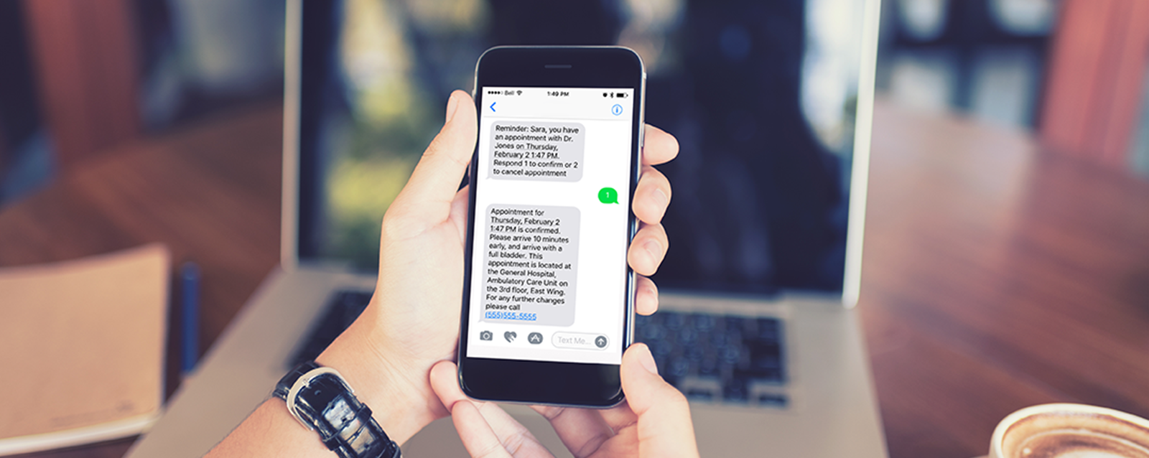
Live Demo
Notes:
SCRIPT
Now comes the fun part. Let’s show you how ACM works!
SWITCH TO ACM

